Slide 1
Internship
DOMAIN : IOT/embedded
Company : ecoparadigm pvt. Ltd.
Submitted by : TIRTH PARMAR(200170111040)

Slide 2
Content
Company profile
Tools and technology
Presentations
Project work
Appendix – Project site visits

Slide 3
Company profile
Ecoparadigm is a leading company specialised in implementing sustainable and eco-friendly development projects. With a unique mix of knowledge and experience, we work in close collaboration with the public and private sectors.
Since the conception of this company, we have gained extensive experience in capacity development, policy building, awareness raising, project implementation and consulting in the field of sustainable water and sanitation management.
The main motto of the company is to help customers on ways to optimise their utilisation of resources and conserve the environment.

Slide 4
Tools and technology
ESP32
Arduino Due
STM32
GPS Modules
HX711 IC & Loadcells
TFT SPI LCD Display(ILI9488)
Telecom Modules

Slide 5
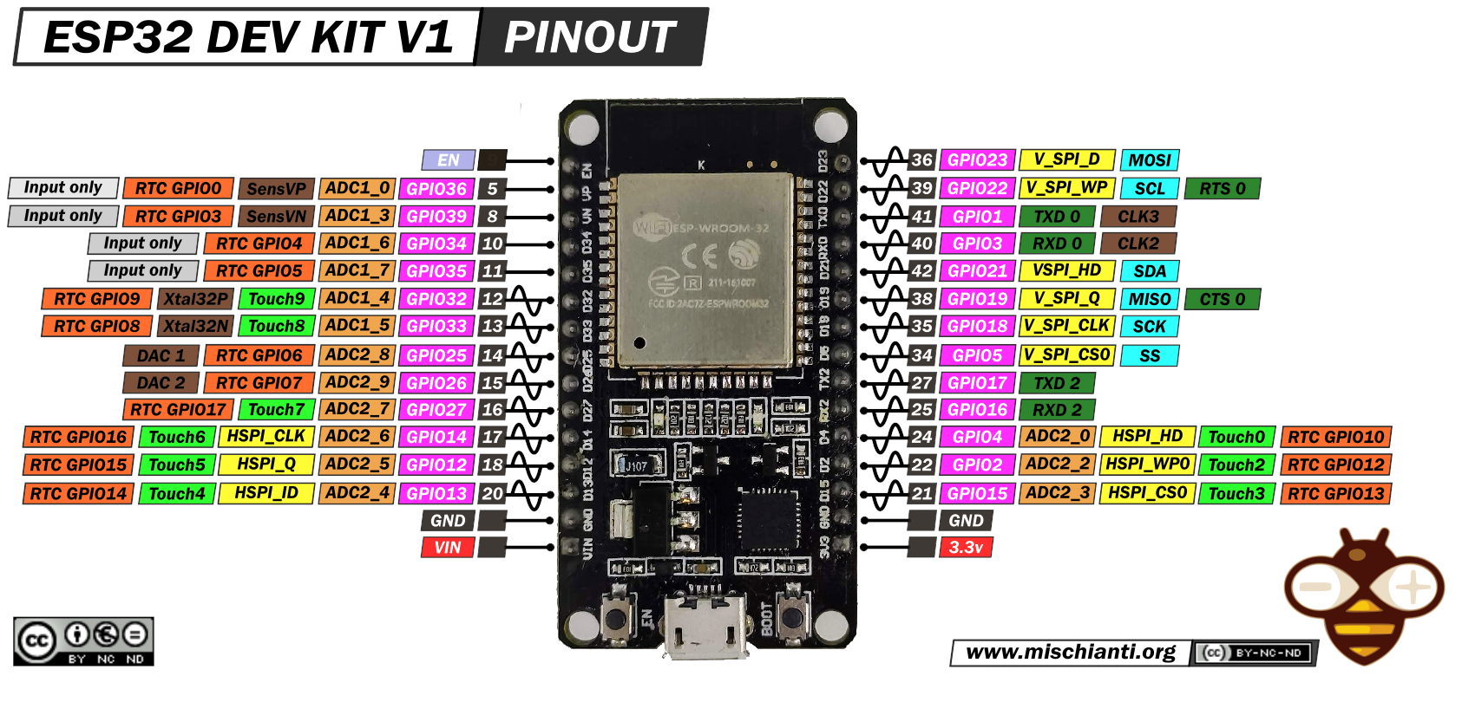
ESP32
The ESP32 microcontroller is a versatile, low-power chip with integrated Wi-Fi and Bluetooth capabilities, ideal for IoT applications.

Slide 6
Arduino due
The Arduino Due microcontroller is a powerful board based on the Atmel SAM3X8E ARM Cortex-M3 CPU, offering 54 digital I/O pins and 12 analog inputs, suitable for demanding projects requiring high computational power and connectivity. It operates at 3.3V, making it compatible with a wide range of sensors and peripherals.

Slide 7
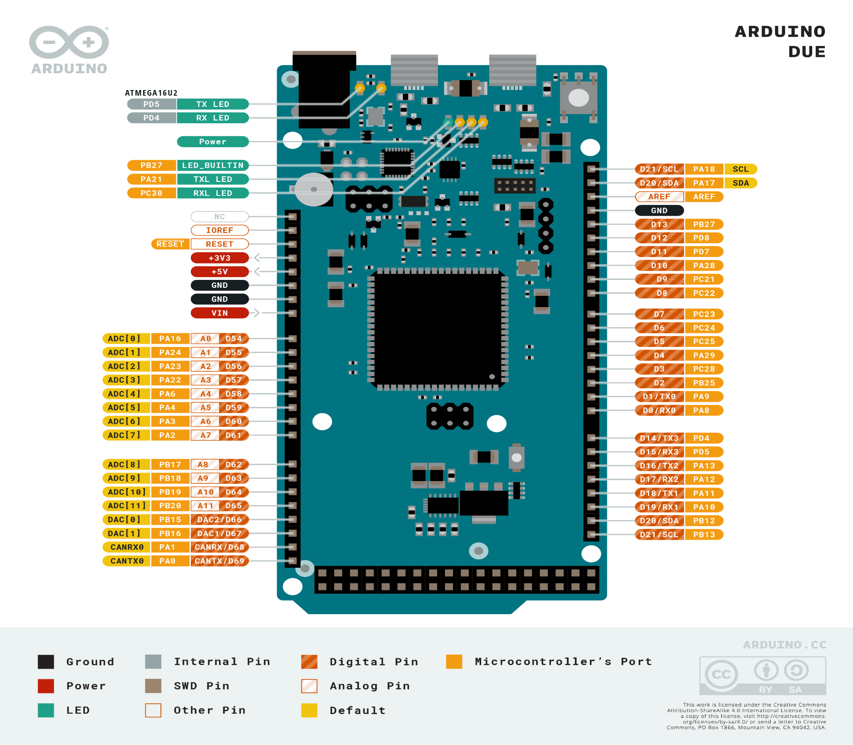

Slide 8
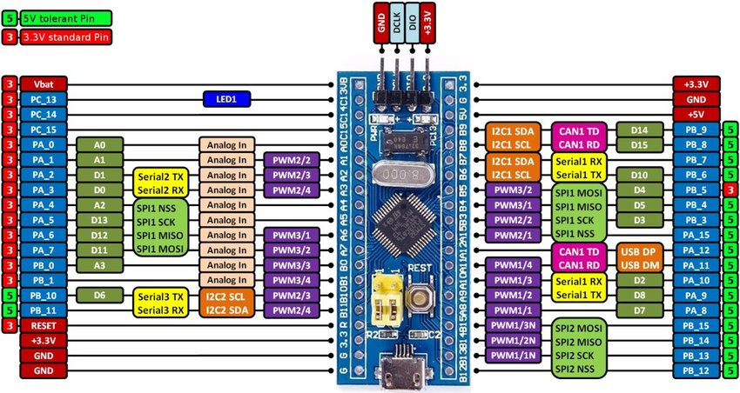
STM32
An STM32 board is a versatile microcontroller platform offering high performance and a wide range of peripherals for embedded applications.

Slide 9
ESP32 vs Arduino due vs STM32
Parameters | ESP32 | Arduino Due | STM32
By cost | Cost effective | Less costly then STM32 | Highest cost
Power Consumption | Higher power consumption | More power consumption then STM32 | Lower power consumption
Wireless Connectivity | In built Wireless Connectivity | No Wireless Connectivity | No Wireless Connectivity
Peripherals | 3 UART,1 SPI, 1 SPI | 4 UART, 2 I2C, 1 CAN | 4 UART, 3 I2C, 3 SPI, 2 CAN
Community and Support | Larger | Medium | Medium

Slide 10
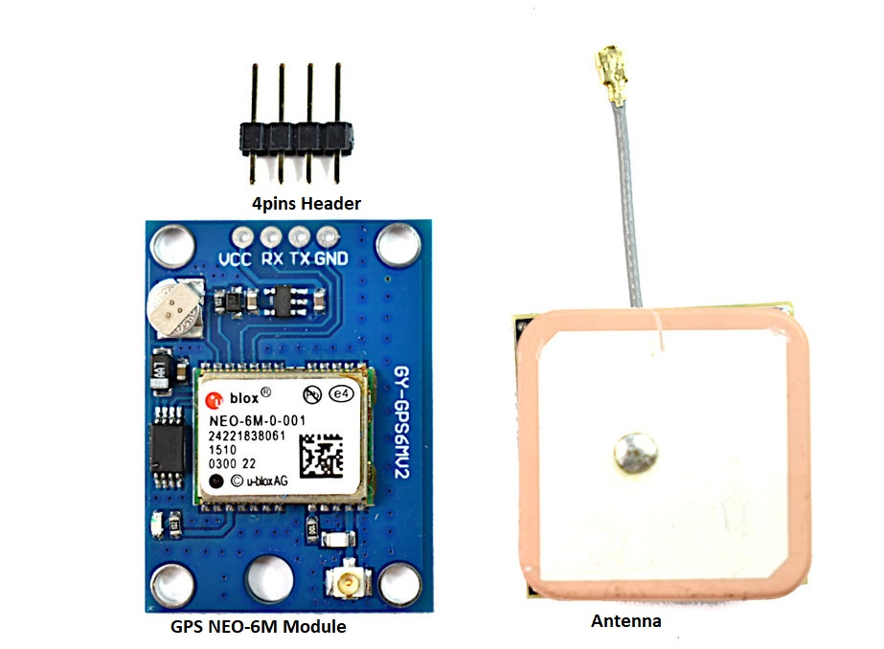
GPS Modules
NEO 6M-Module
It provides accurate positioning information by receiving signals from satellites orbiting the Earth. This module can determine precise location coordinates, altitude, speed, and time, making it useful for a wide range of applications requiring location-based services.

Slide 11
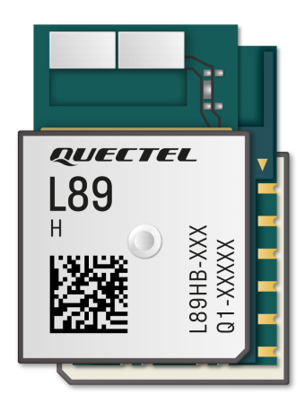
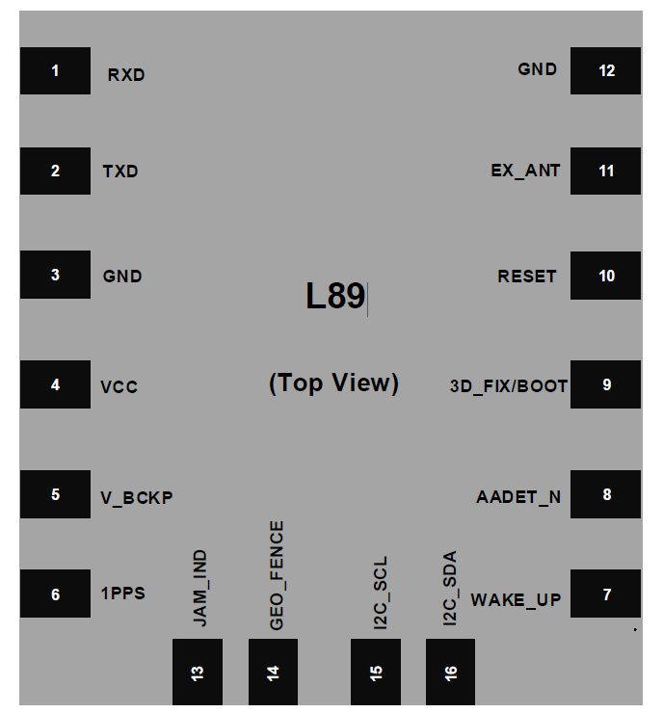
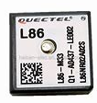
L89/L86 Modules

Slide 12
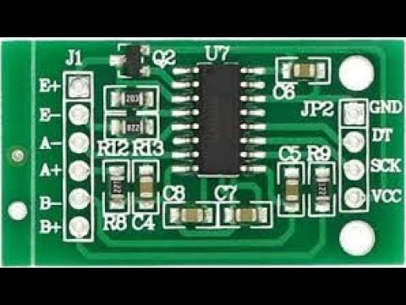
HX711 IC & Loadcells
HX711 IC
The HX711 IC is a high-precision analog-to-digital converter designed for accurate weight measurement applications, featuring signal amplification, serial interface, and tare functionality.

Slide 13
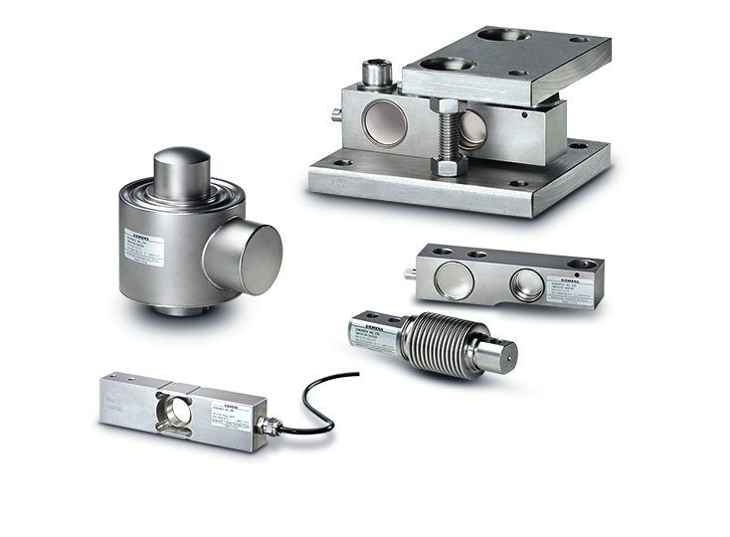
Loadcells
Load cells are transducers that convert force or weight into an electrical signal, commonly used for precise measurement in scales and industrial applications.

Slide 14
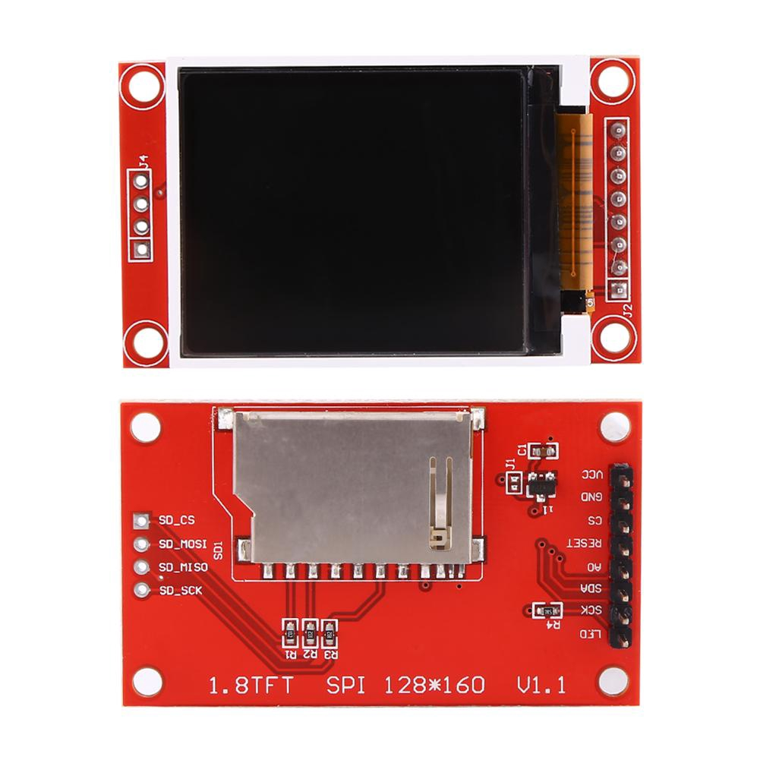
TFT SPI LCD Display(ILI9488)
A TFT SPI LCD display is a type of screen that utilizes thin-film transistor technology and communicates with a microcontroller using the Serial Peripheral Interface protocol, offering vibrant color and high resolution for visual output.

Slide 15
Telecom Modules
Bluetooth Modules
Wi-Fi Modules
Zigbee Modules
Cellular Modules

Slide 16
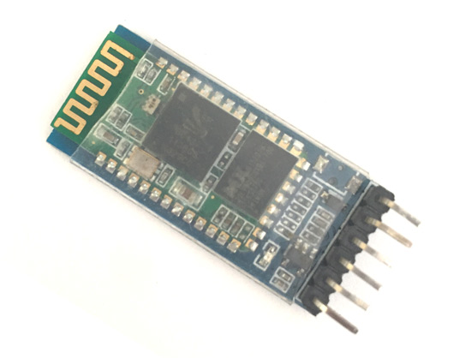
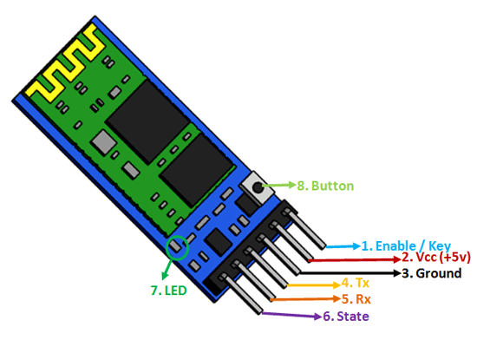
Bluetooth Modules
Used for short-range wireless communication between devices.

Slide 17
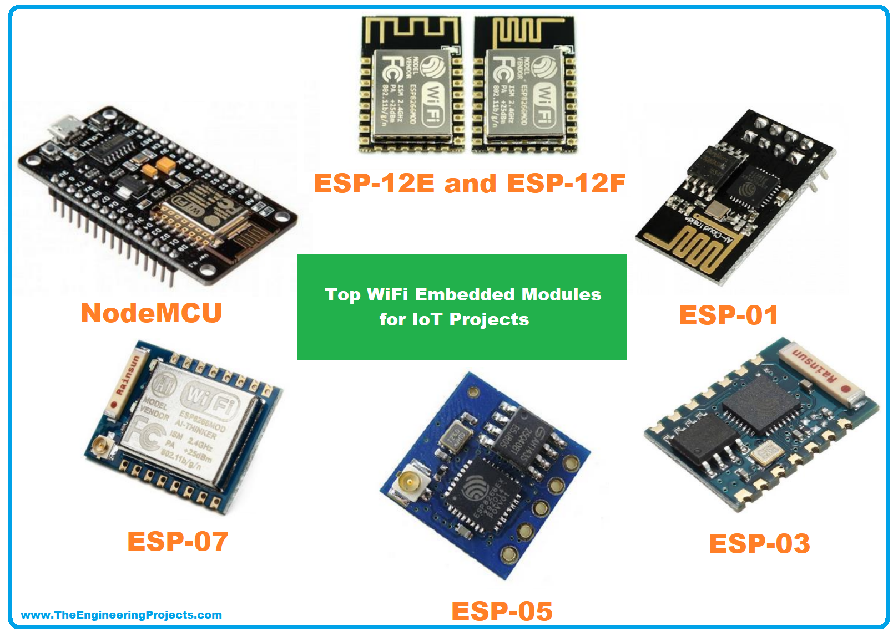
Wi-Fi Modules
Enable wireless internet connectivity.

Slide 18
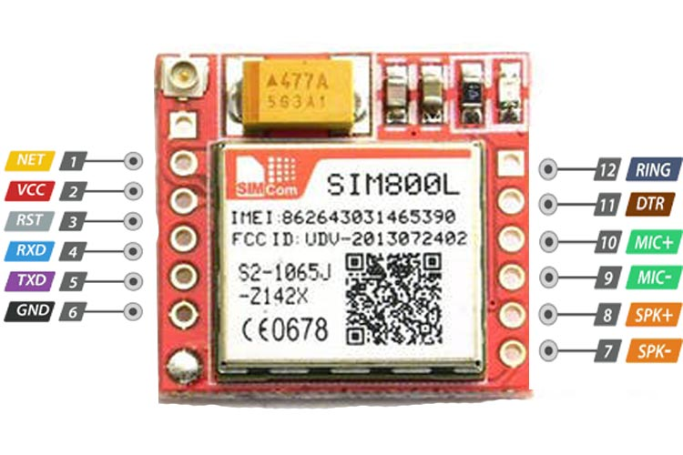
Cellular Modules
Designed for low-power, short-range communication in home automation and industrial applications.

Slide 19
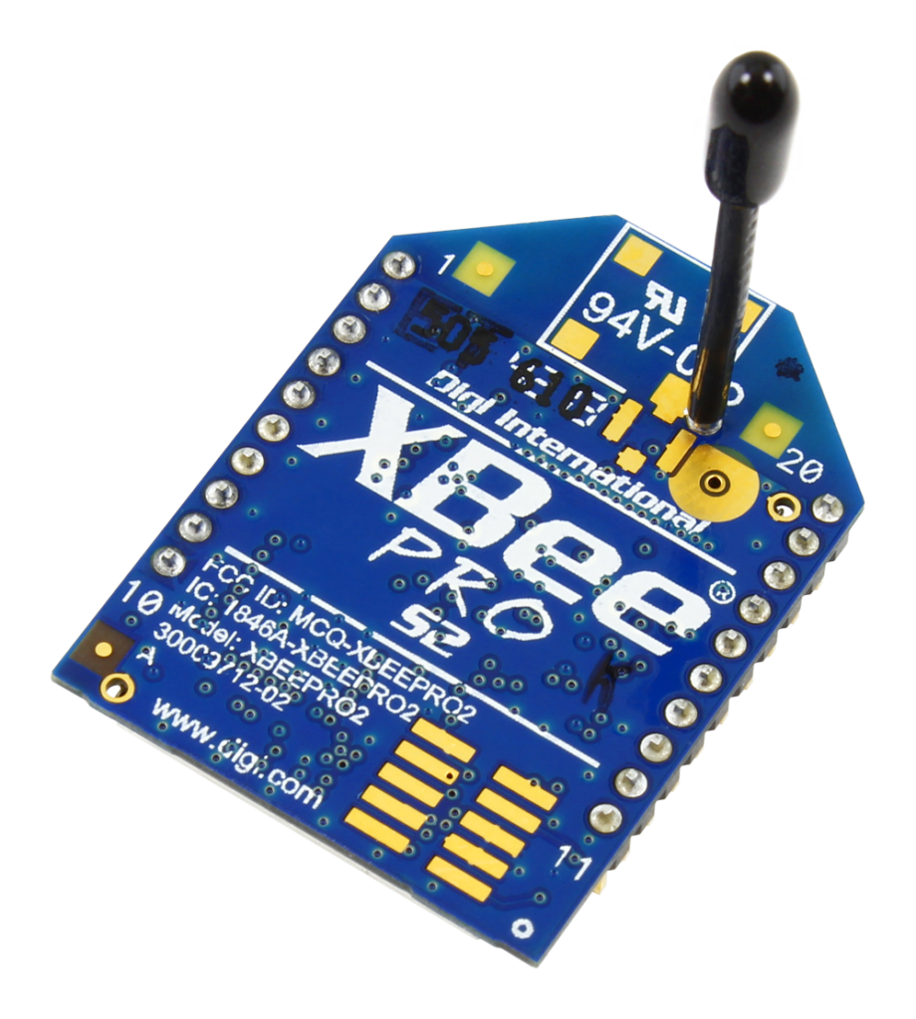
Zigbee Modules
Used for mobile communication and internet access.

Slide 20
Presentations
Digital communication protocol
Switching devices
SMPS

Slide 21
Digital communication protocol
UART
USART
SPI
I2C
CAN
TWAI
I2S
RS232

Slide 22
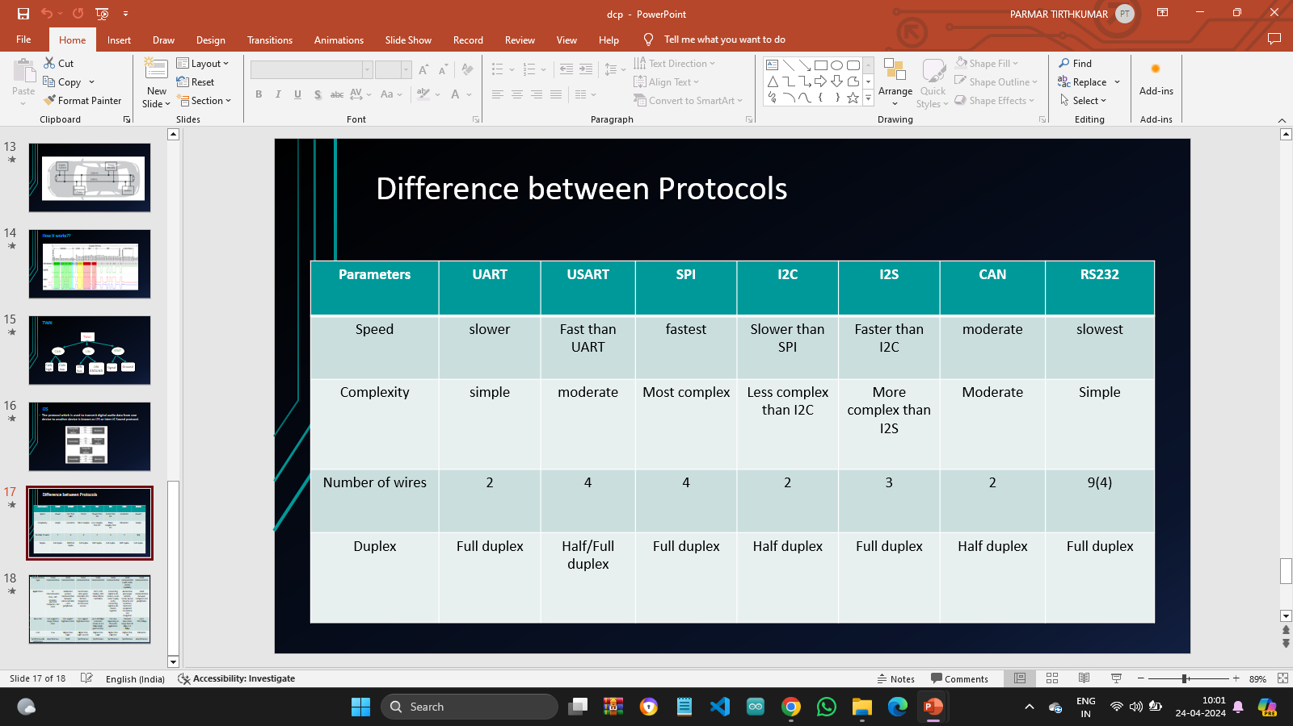
Difference between all the protocols

Slide 23
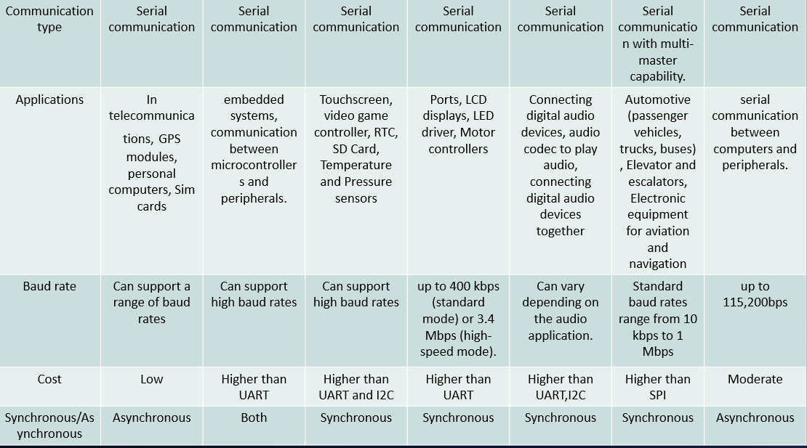

Slide 24
Switching devices
Relay
Transistor
Vacuum tubes
Optocoupler
Contactor Devices
MCB

Slide 25
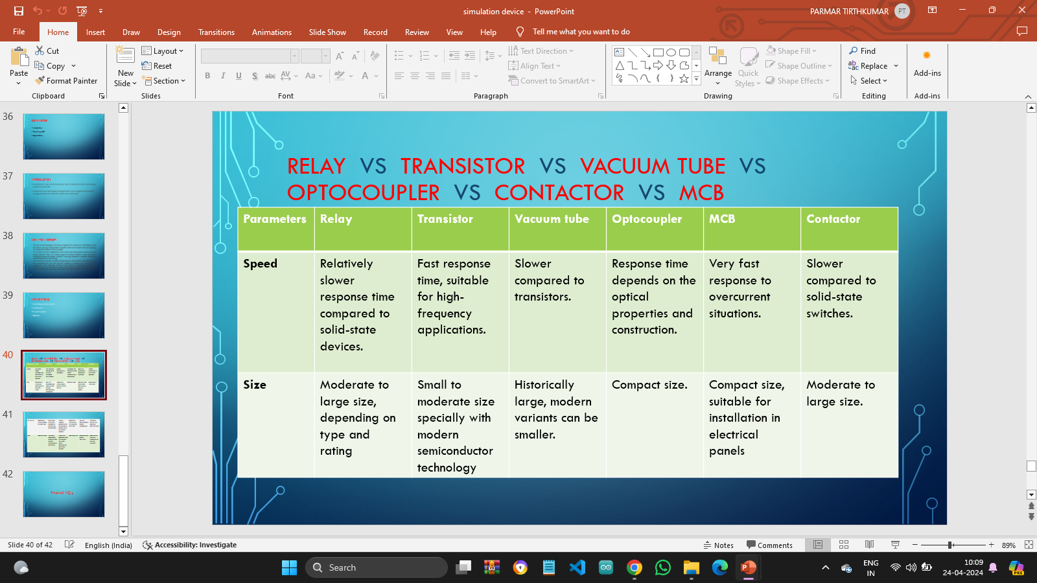
Switching devices comparison

Slide 26
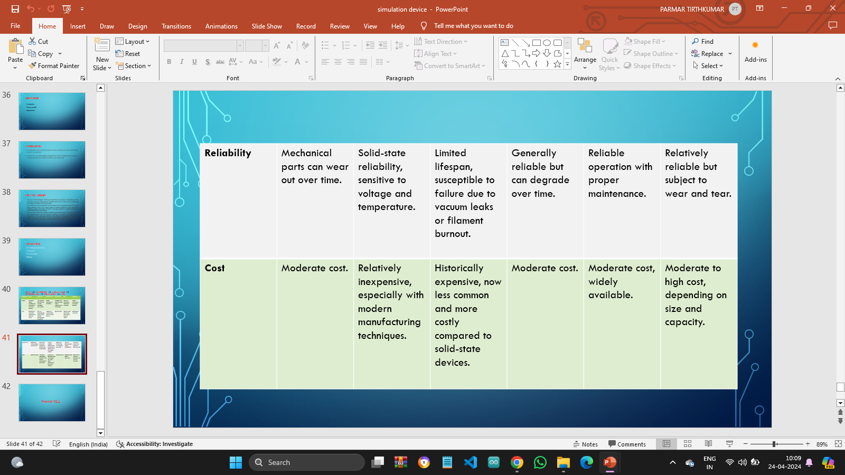

Slide 27
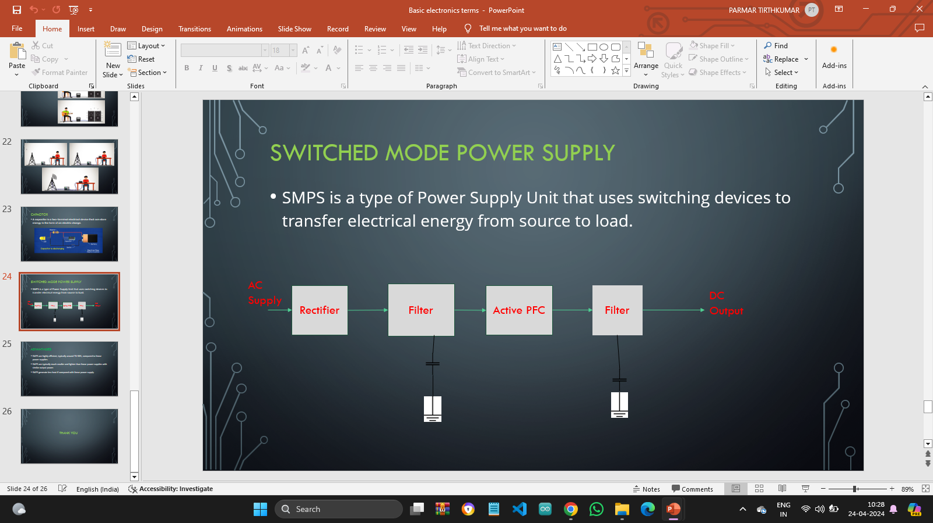
SMPS

Slide 28
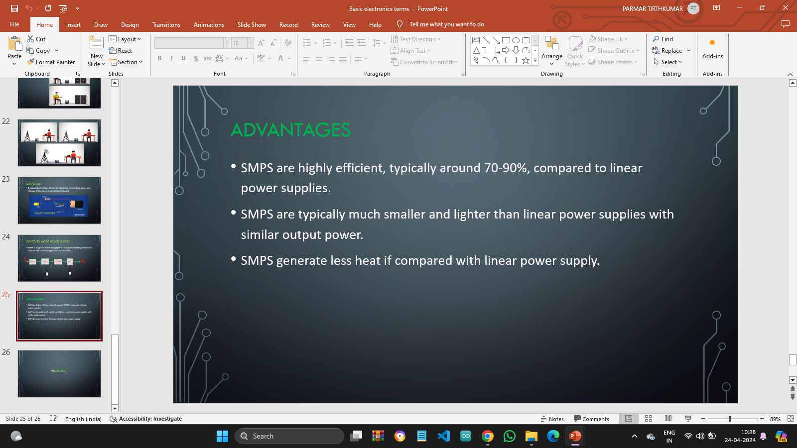

Slide 29
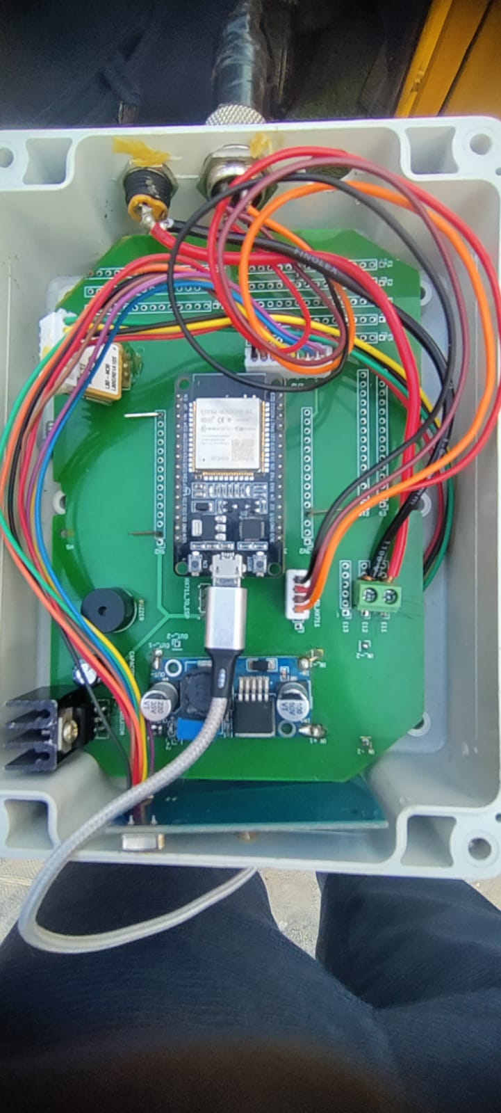
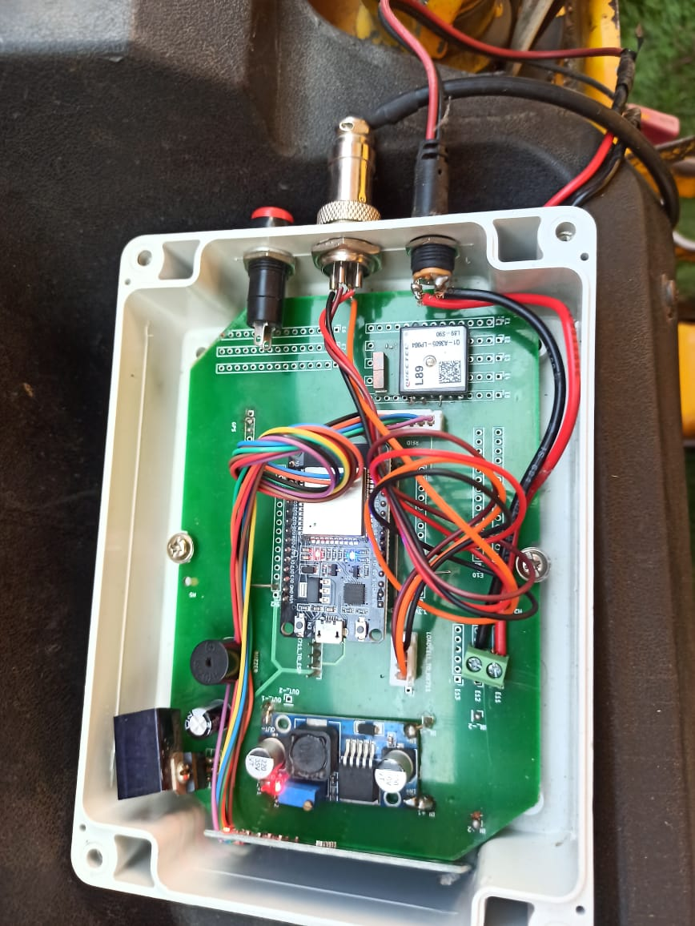
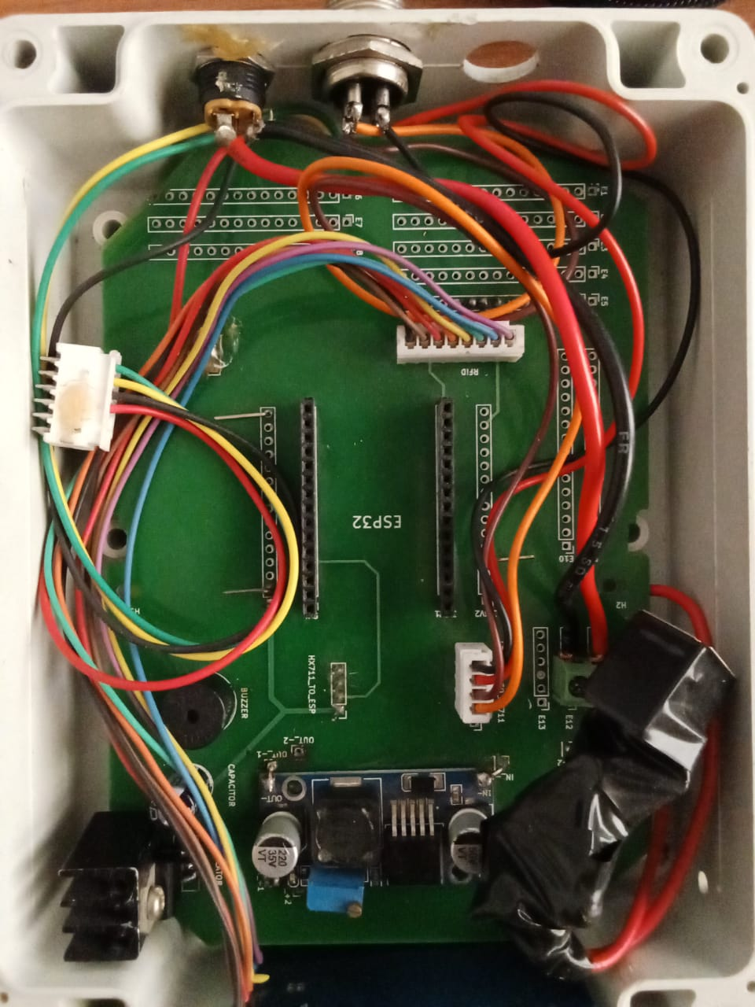
Project work

Slide 30
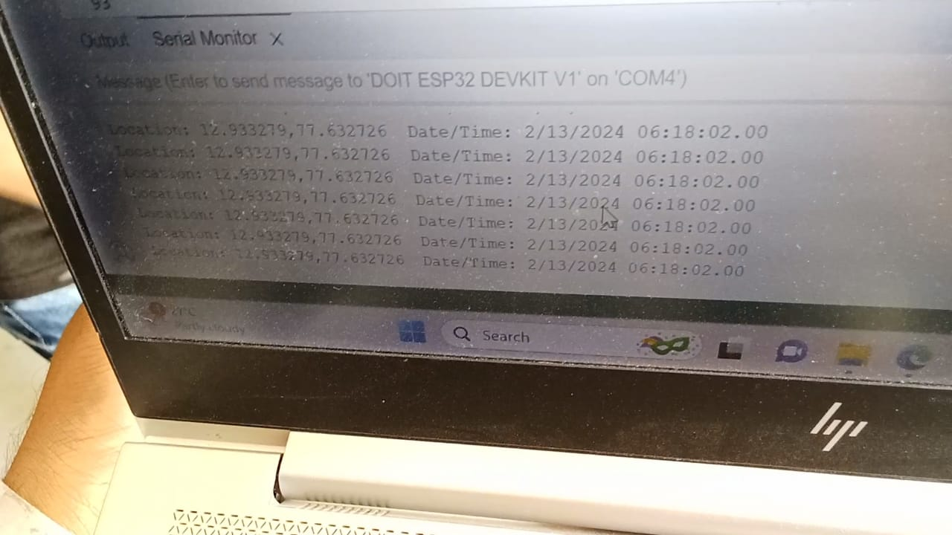
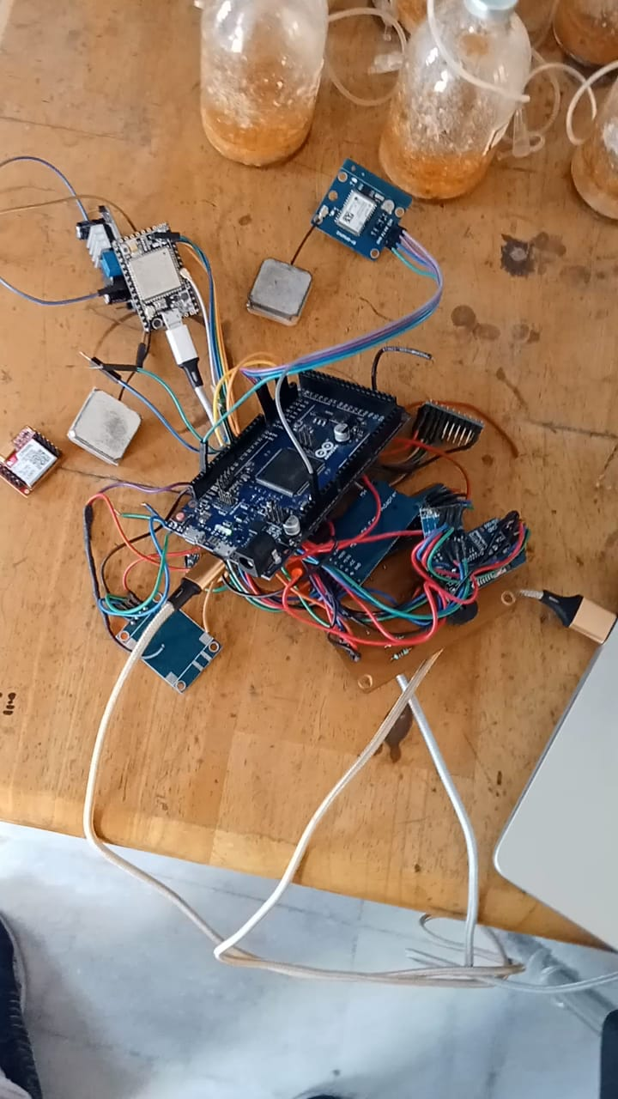
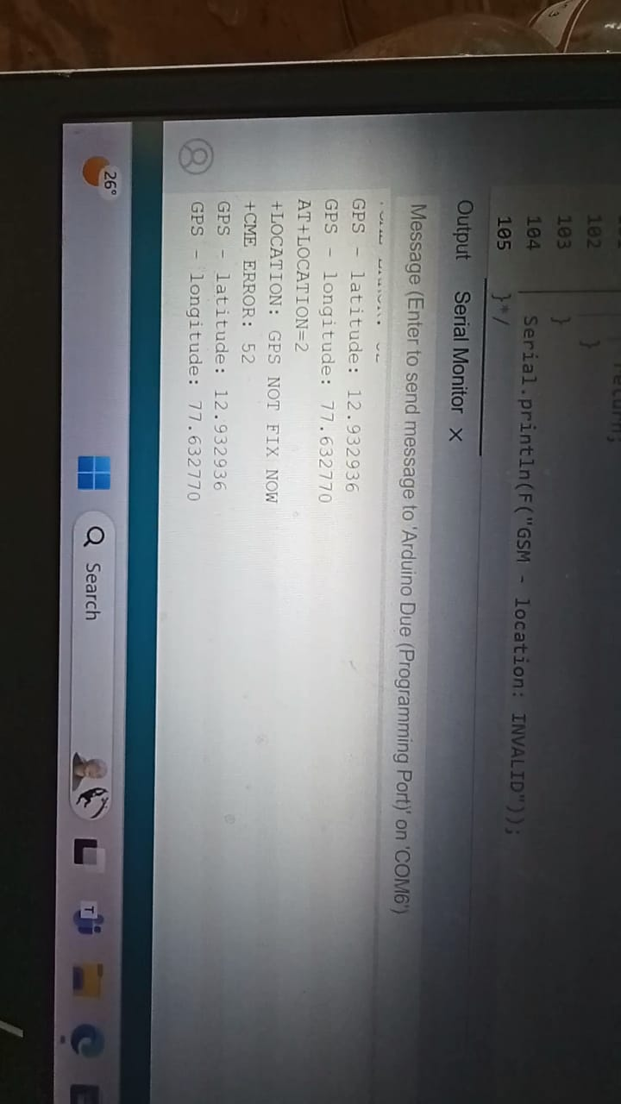

Slide 31
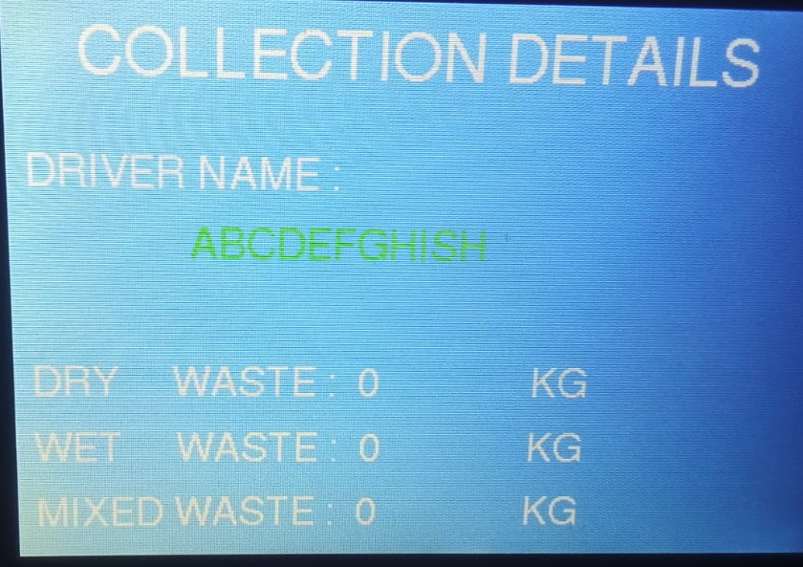
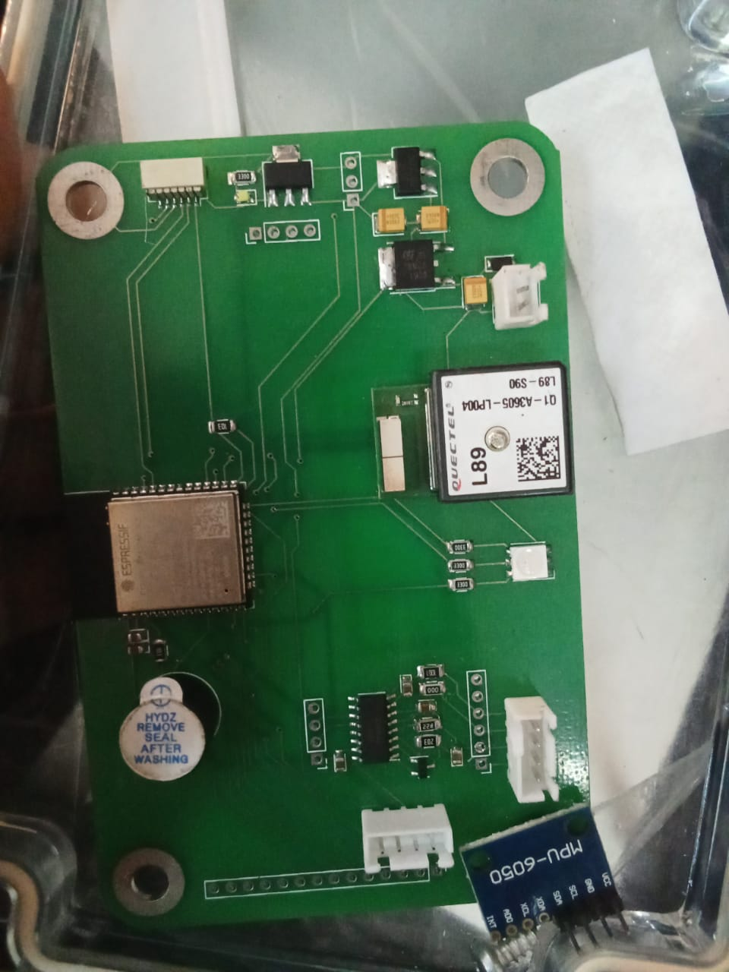
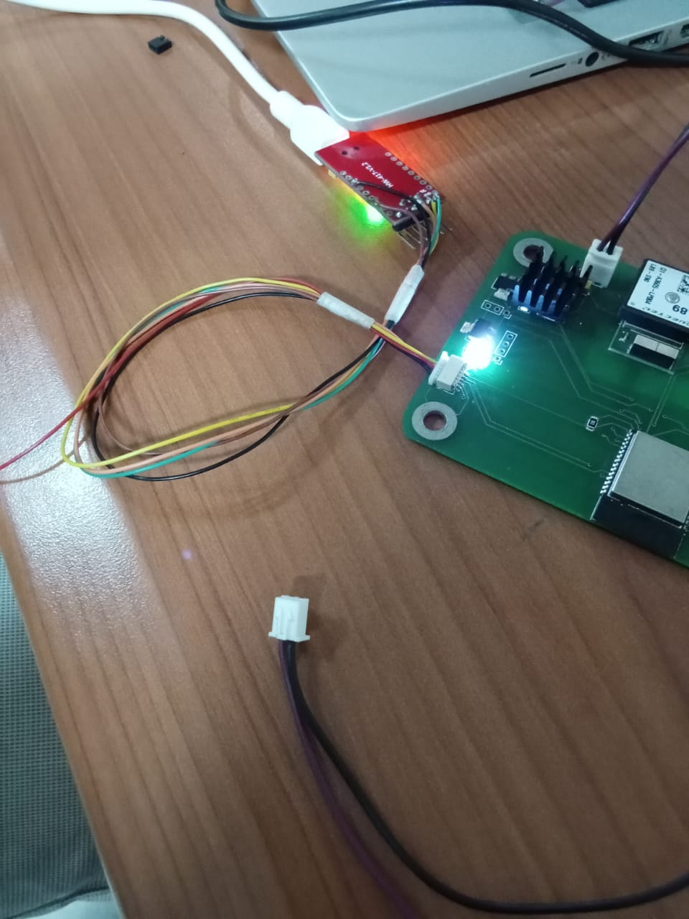
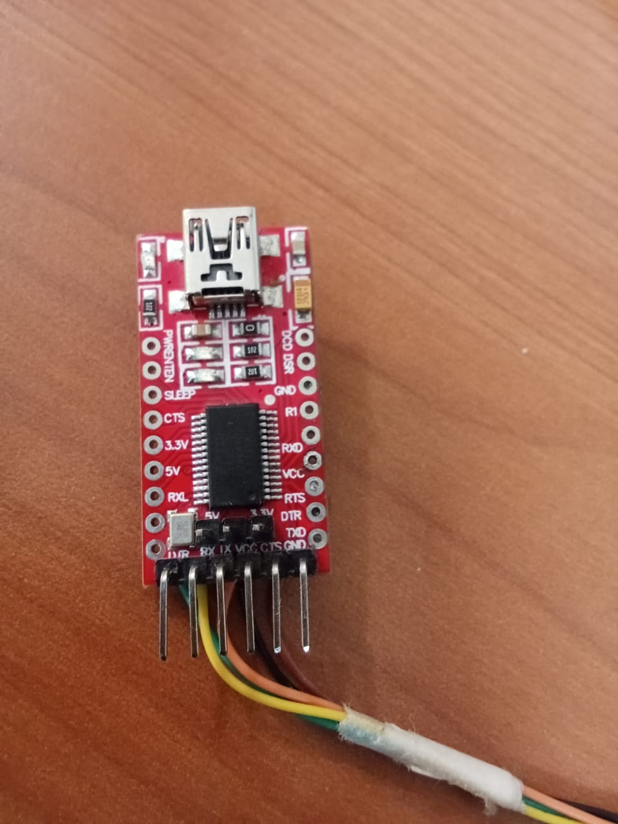

Slide 32
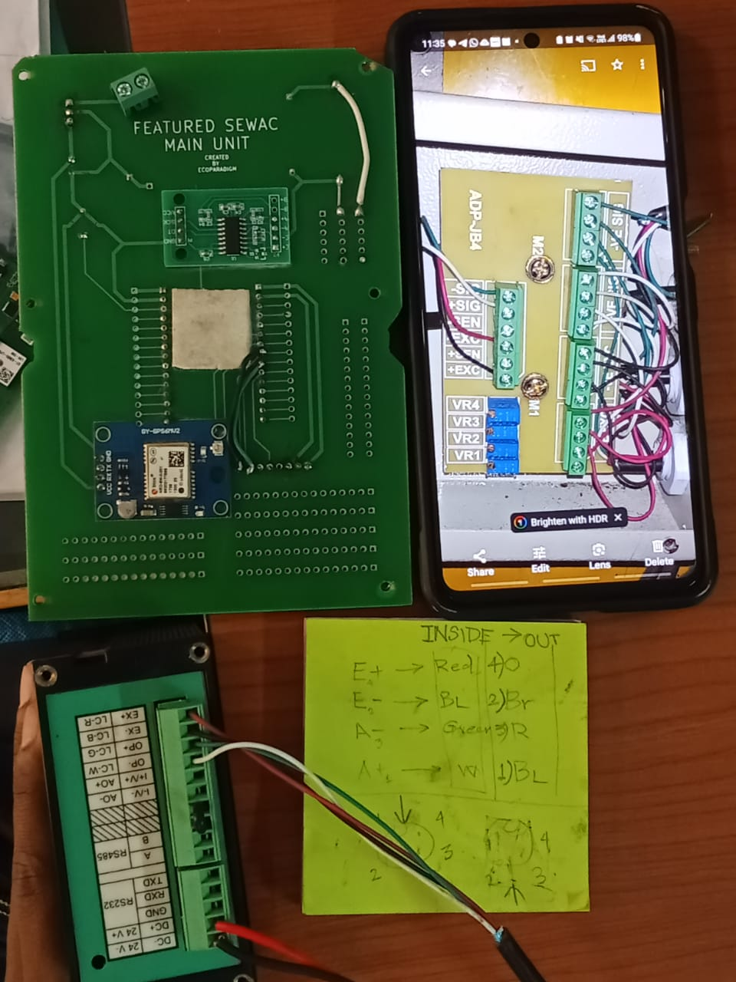
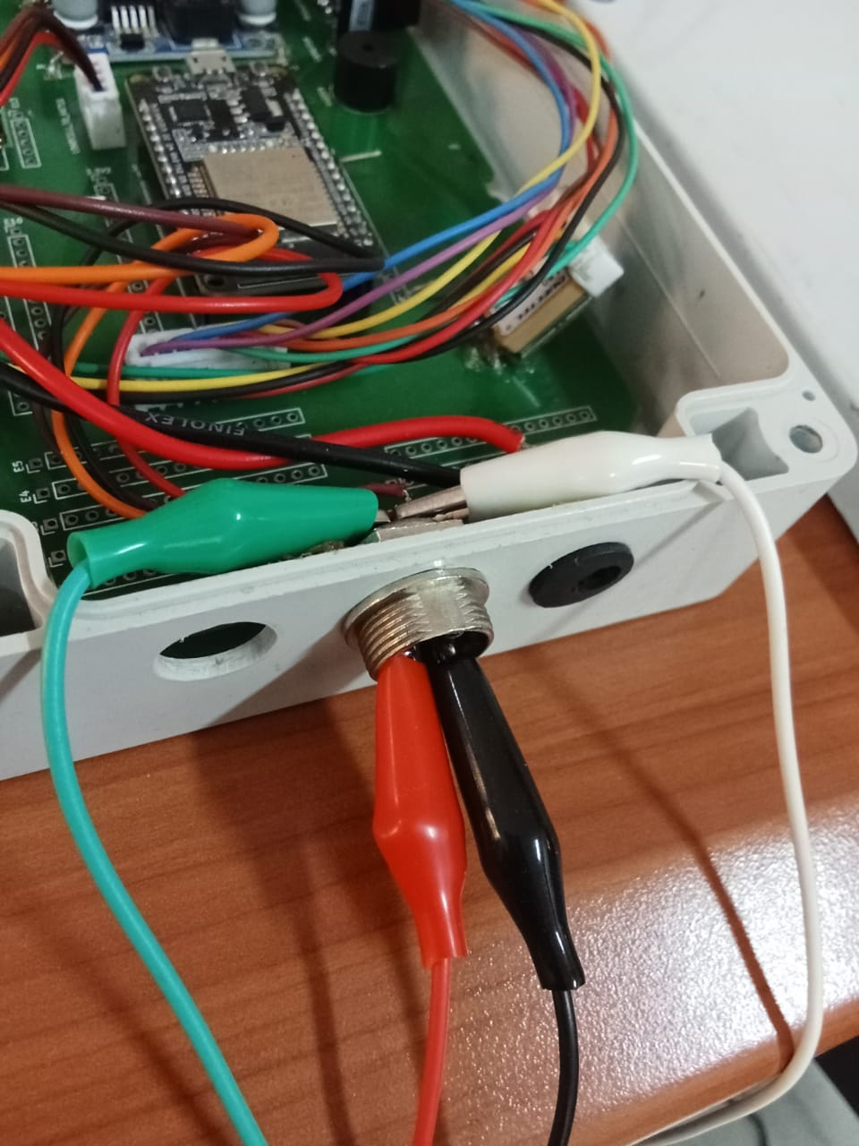

Slide 33
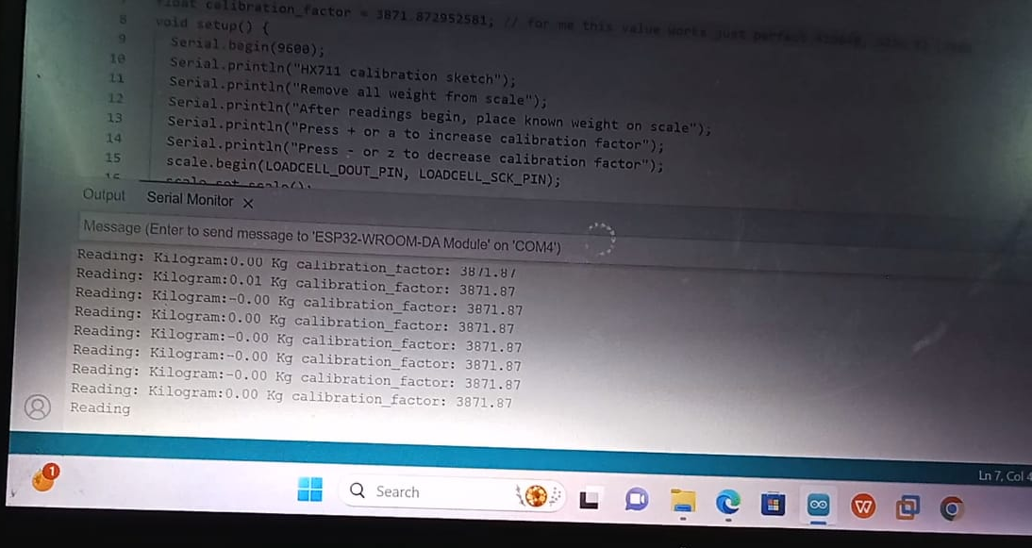

Slide 34
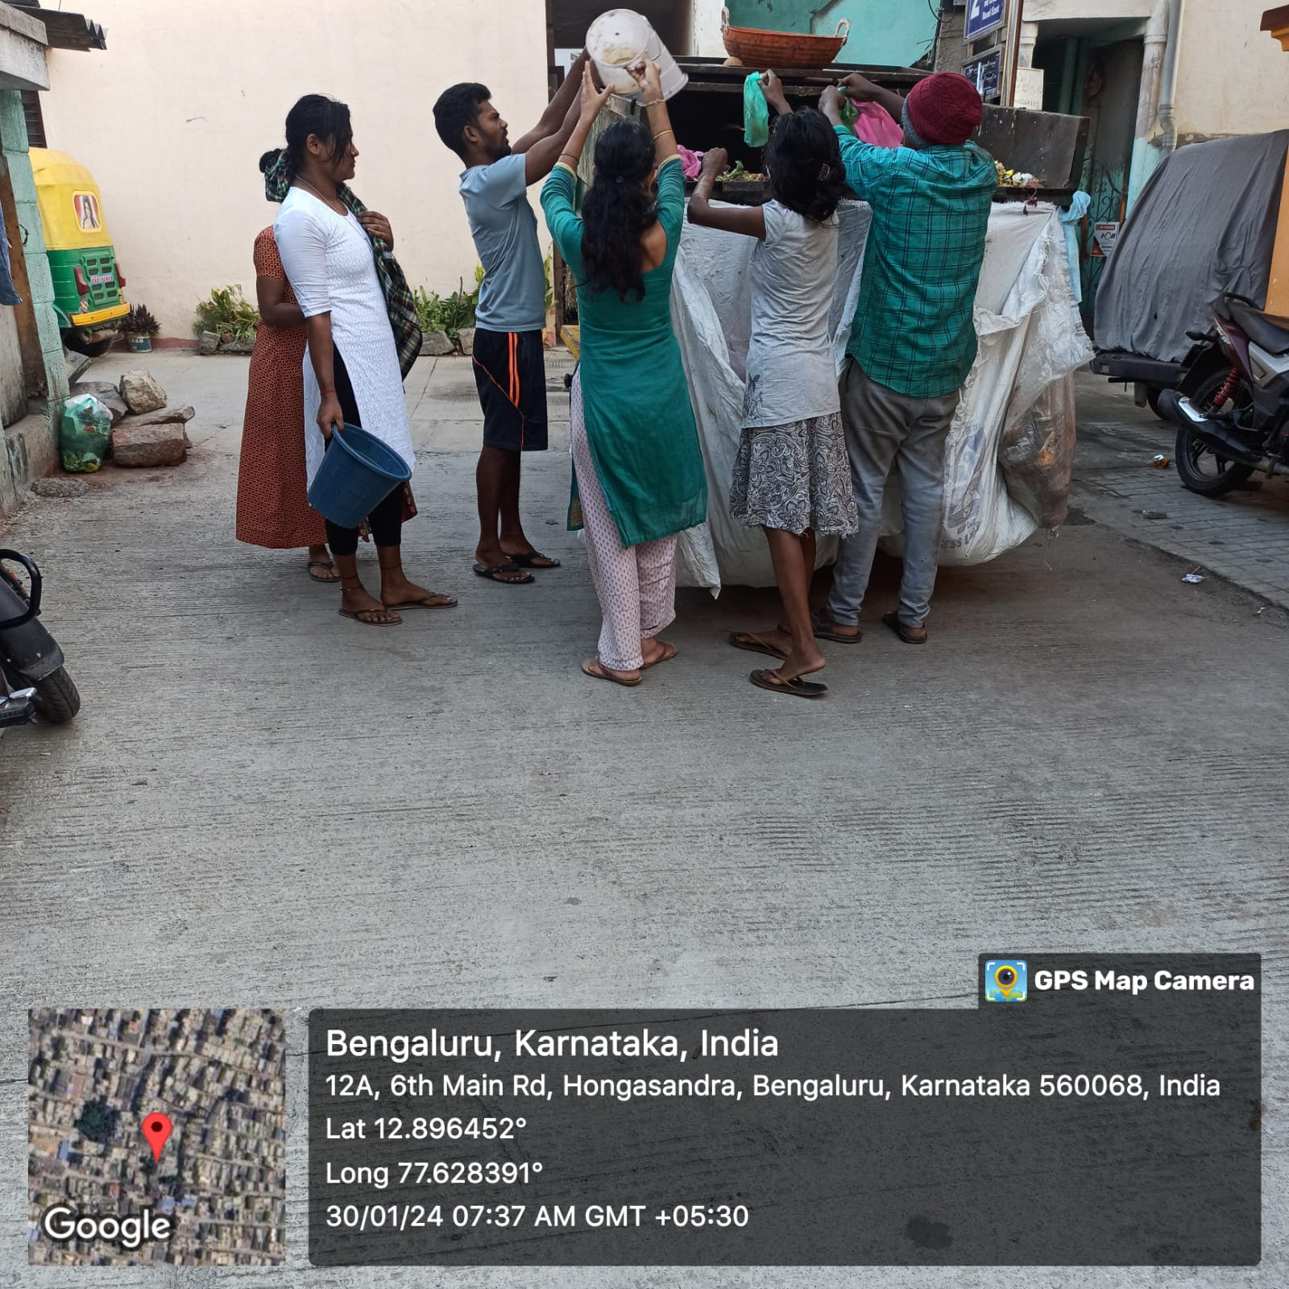
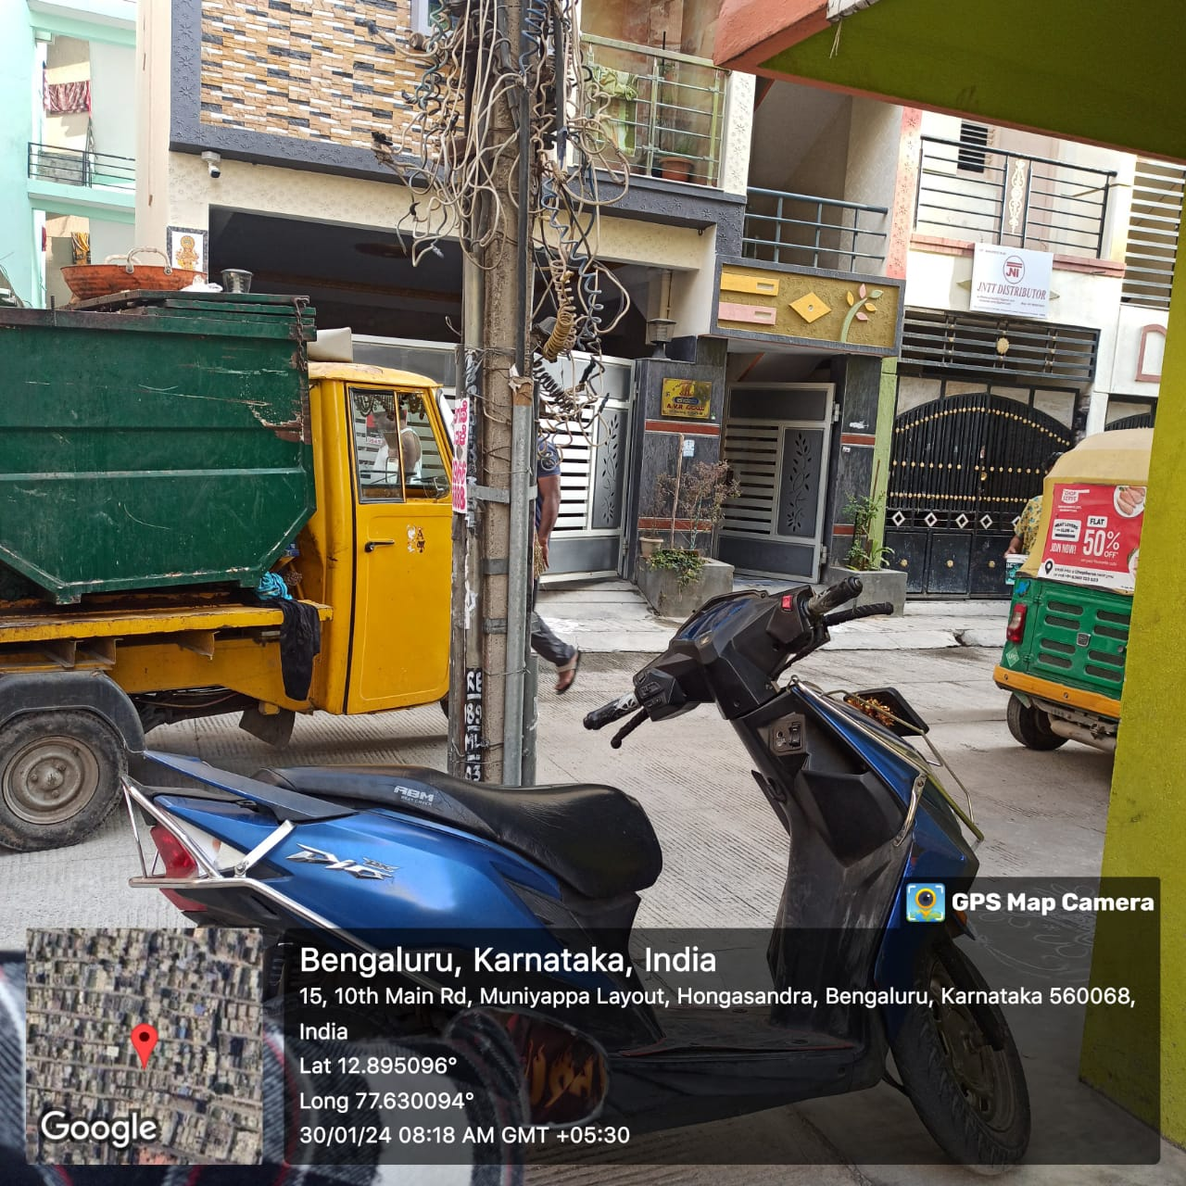
Appendix – Hongasandra-1

Slide 35
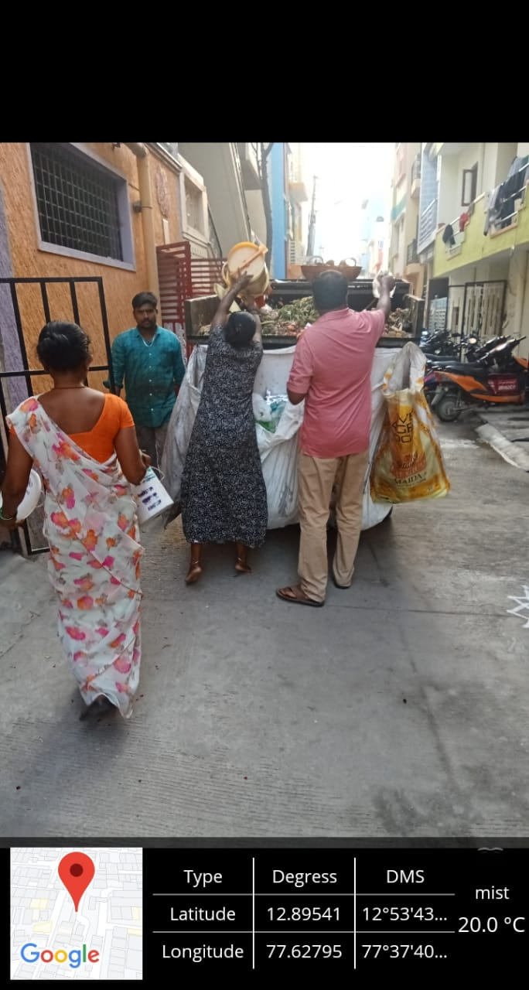
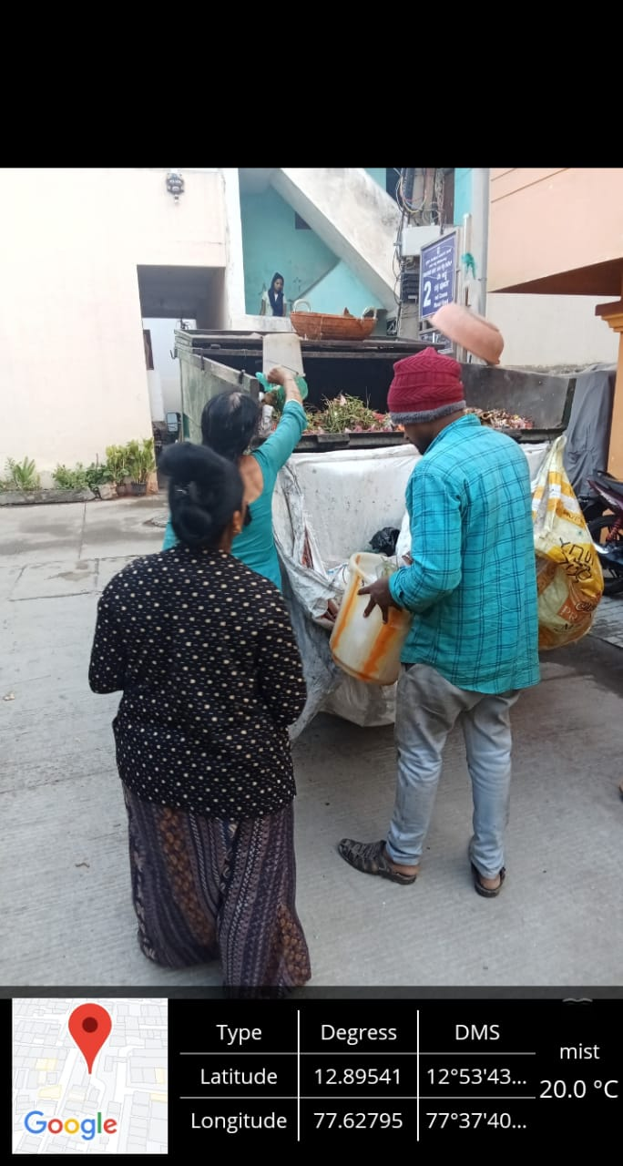
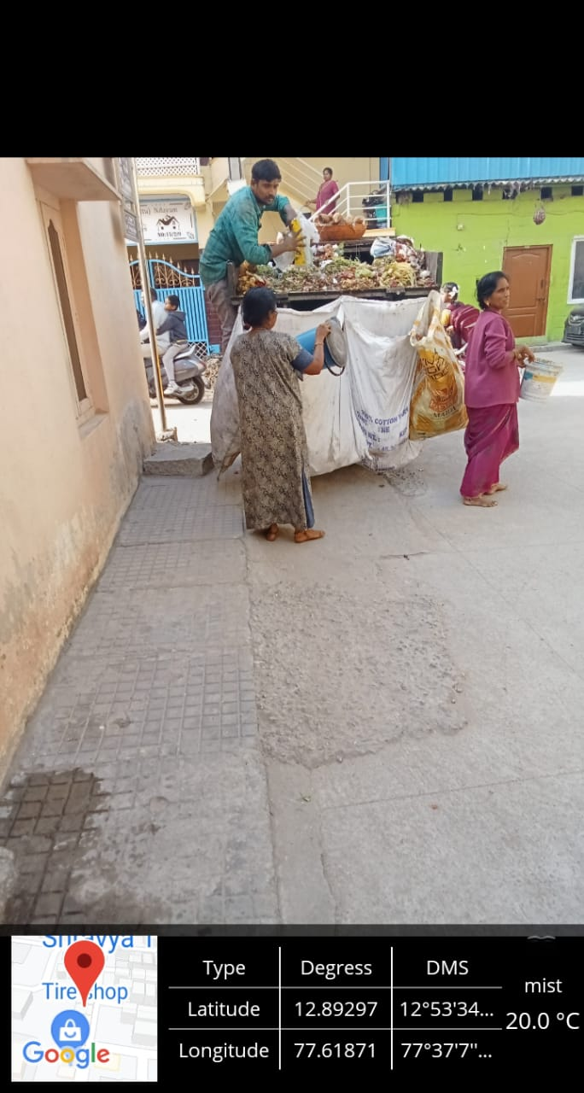

Slide 36
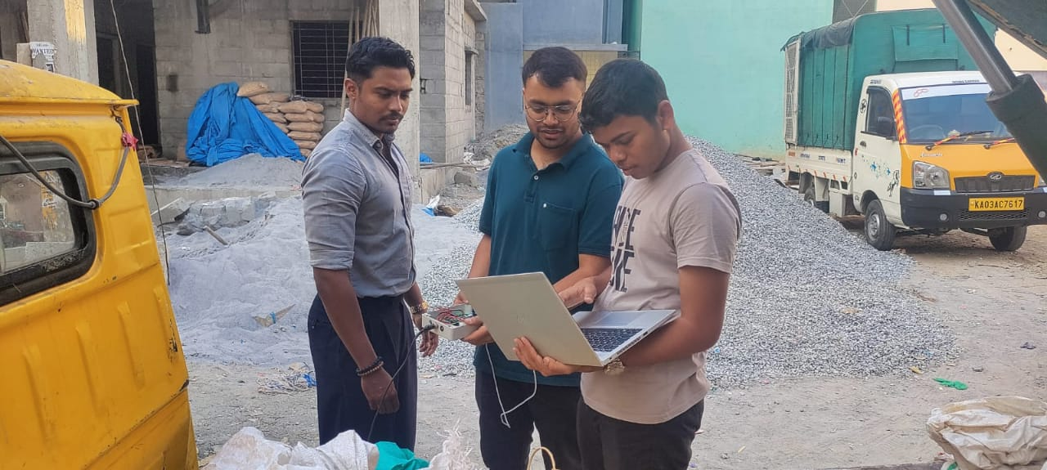
Appendix – Hongasandra-2

Slide 37
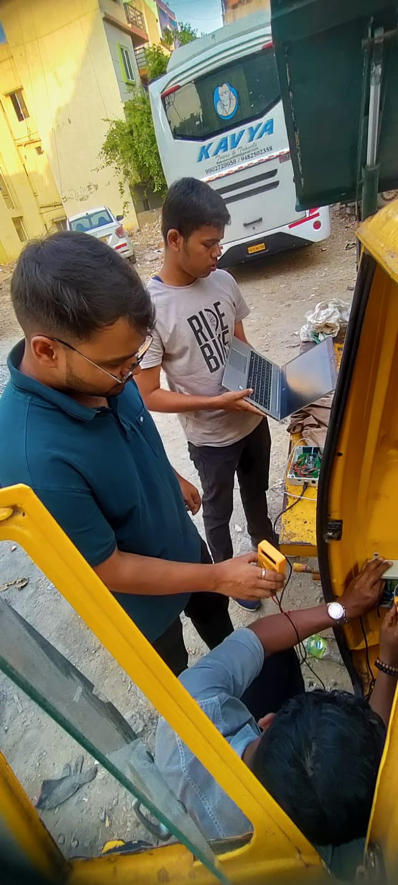
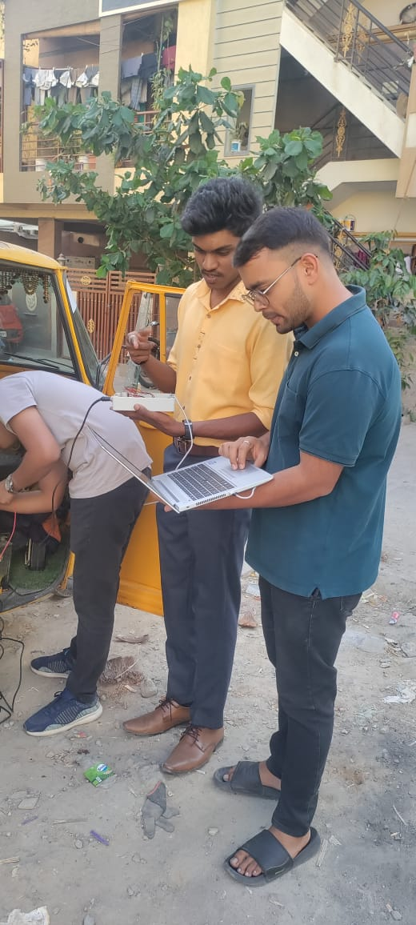

Slide 38
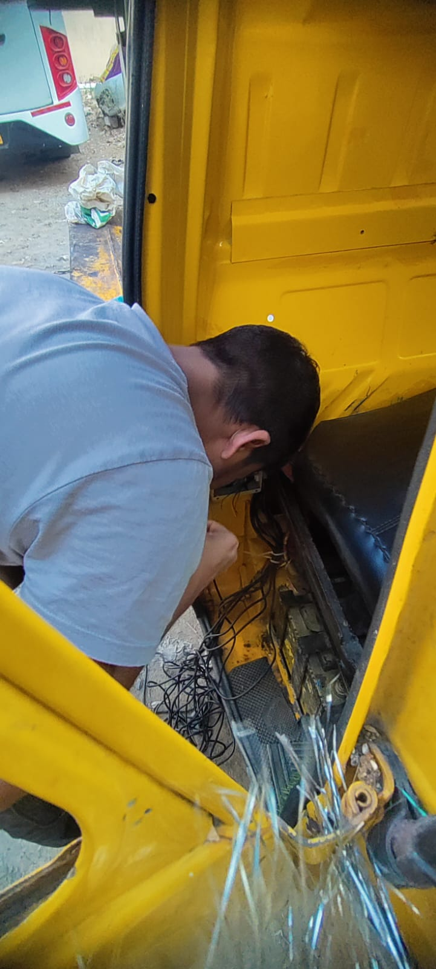
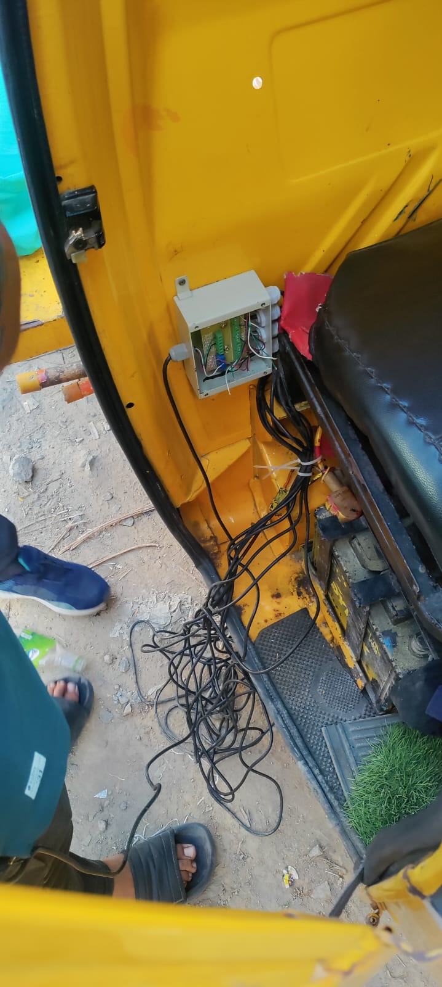

Slide 39
References
https://th.bing.com/th/id/OIP.anIj76jQybMOQs28GvzwkAHaDo?rs=1&pid=ImgDetMain
https://th.bing.com/th/id/OIP._9yItdk_Y5U4-xAnduU_-QAAAA?rs=1&pid=ImgDetMain
https://www.researchgate.net/profile/Tolotra-Samuel-Randriakotonjanahary/publication/338954801/figure/fig8/AS:853470546493447@1580494643280/9-STM32-pinout-diagram.jpg
https://blog.asksensors.com/wp-content/uploads/2020/04/gps.jpg
https://i.ytimg.com/vi/FzgqbPkJgNA/hqdefault.jpg
https://components101.com/sites/default/files/components/HC-05-Bluetooth-Module.jpg
https://www.theengineeringprojects.com/wp-content/uploads/2021/08/Top-WiFi-Embedded-Modules-for-IoT-Projects.png

Slide 40


